Slide 1
Data readiness, AI roadmap
and your 90-day plan
Is our data ready, and what do we do in the next 90 days?
Leading with AI | Session 14 of the 15 (Sessions 0 to 14)
KLAi Professional Learning | Jotham Martin Wambi
Notes:
Welcome to the last session. Last time you wrote the rules: an AI use policy, a risk register and the questions for vendors. Rules need good data underneath them, and that is where we finish. Over fourteen sessions you learned what AI can do, how to choose and use it, how to control the risk, and how to lead the change.
Today the question is your own organisation’s: is our data ready, and what do we do in the next ninety days?
You leave with a decided portfolio, a plan with owners, and three dates.

Slide 2



What you will leave with today
By the end of today you will have
Judge whether your data is ready for AI: an inventory, quality counted, and a readiness scorecard out of 12
Finish your AI Opportunity Portfolio: every entry with value, feasibility, people, risk, data readiness and a decision
Leave with a 90-day plan: owners, dates, success measures and check-ins at day 30, 60 and 90
Notes:
That question breaks into three things you will leave with. First, a judgement on your data: what you hold, what is wrong with it, counted, and a readiness scorecard out of twelve. Second, your AI Opportunity Portfolio finished: every entry with its value, feasibility, people, risk and data readiness, and a decision for each.
Third, a ninety-day plan in which every action has an owner, a date and a measure someone else can check, with check-ins at day thirty, sixty and ninety.

Slide 3
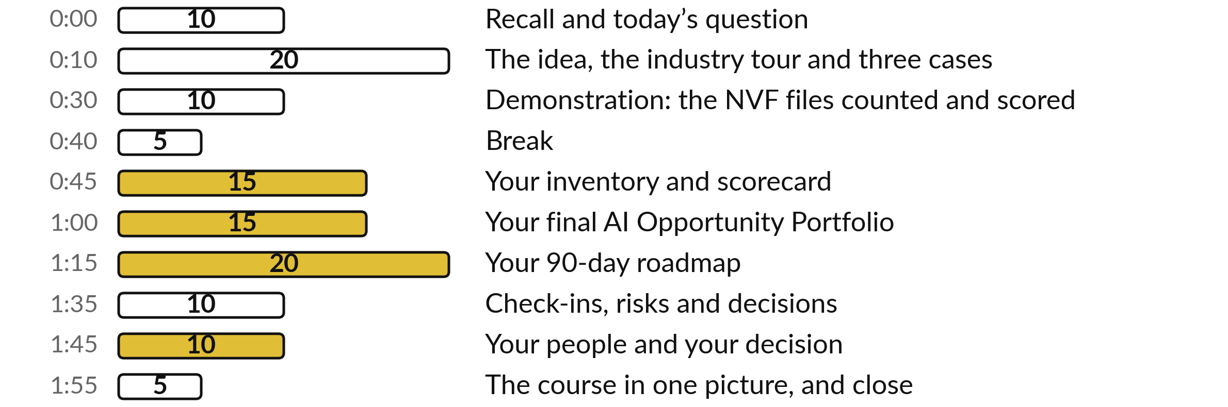
Your last two hours: an hour
of them builds your own plan
60 of the 120 minutes are yours: inventory, scorecard, portfolio, roadmap and check-ins.
Notes:
Here is how the last two hours run. Ten minutes to recall Session 13 and meet the question. Twenty on the idea, the industry tour and three cases, then ten on a recorded demonstration that counts what is wrong in our fictional company’s files. After a five-minute break, a full hour is yours: your inventory and scorecard, your final portfolio, your roadmap, and your check-ins.
Then ten minutes on your people and one decision, and five to look back over all fifteen sessions. First, three questions from last time.

Slide 4
Three questions from last time
1. In Session 13, why is an AI use policy better than a ban?
2. In Session 13, how did staff decide what may go into an AI tool?
3. Which Ugandan law covers personal data used in AI tools, and who confirms what it asks of you?
Answer aloud first. Then we check together.
Notes:
Three quick questions from Session 13. Answer aloud first, and then we check together.
Question one. In Session 13, why is an AI use policy better than a ban? Take a moment.
A good answer is this. A ban pushes use out of sight, the shadow AI of Session 0. A policy says which tools are approved, for which data, and who checks.
Question two. In Session 13, how did staff decide what may go into an AI tool? Say it to yourself first.
A good answer is this. Four questions in order: does it name a living person (Personal), would it harm us if it leaked (Confidential), is it for staff only (Internal), is it already published (Public). The strictest answer wins. This is data classification.
Question three. Which Ugandan law covers personal data used in AI tools, and who confirms what it asks of you? Think about your own work as you answer.
A good answer is this. The Data Protection and Privacy Act, 2019. Your lawyer confirms which duties apply to your uses.
If an answer was missing, last session’s take-away sheet has it.

Slide 5
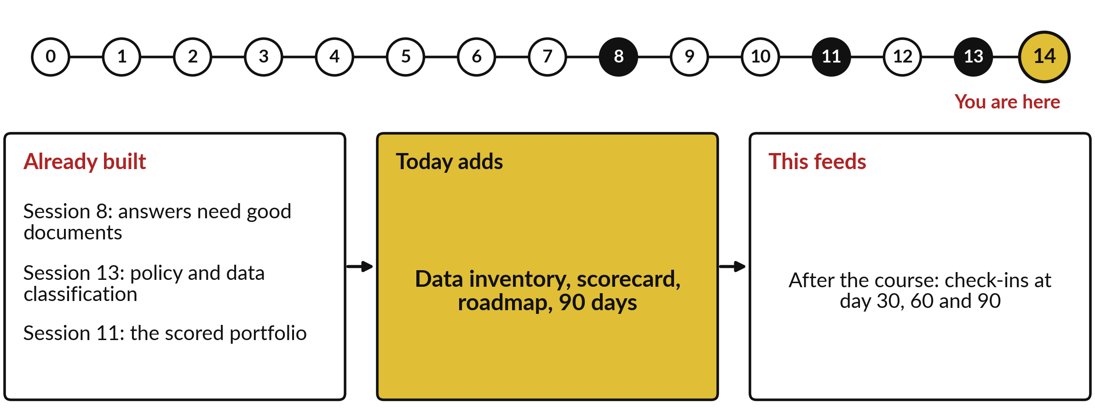
What today builds on, and where it leads
Each session is built on the ones before it.
Notes:
The dots along the top are the fifteen sessions, from the map at Session 0 to your plan at Session 14; the gold one is today.
Today uses answers need good documents from Session 8, policy and data classification from Session 13 and the scored portfolio from Session 11.
It adds data inventory, scorecard, roadmap, 90 days.
After the course: check-ins at day 30, 60 and 90.

Slide 6
Words we use today
Word | What it means
Data inventory | A written list of every data source you hold, with its owner, where it lives and who may see it.
Data quality checks | Counts of what is missing, wrong, doubled or out of date. The industry calls them data quality dimensions.
Data owner | The named person who decides who may use a source and signs off its fixes.
Readiness scorecard | Six areas rated Green, Amber or Red by a written rule, scored out of 12.
Roadmap and milestone | A plan of actions in order, with owners and dates. A milestone is a dated checkpoint.
Success measure | A number someone else can check, such as 0 faults by 19 February. Also called a KPI, key performance indicator.
Notes:
6 words for today. We use every one of them before the end of the session.
Data inventory. A written list of every data source you hold, with its owner, where it lives and who may see it.
Data quality checks. Counts of what is missing, wrong, doubled or out of date. The industry calls them data quality dimensions.
Data owner. The named person who decides who may use a source and signs off its fixes.
Readiness scorecard. Six areas rated Green, Amber or Red by a written rule, scored out of 12.
Roadmap and milestone. A plan of actions in order, with owners and dates. A milestone is a dated checkpoint.
Success measure. A number someone else can check, such as 0 faults by 19 February. Also called a KPI, key performance indicator.

Slide 7
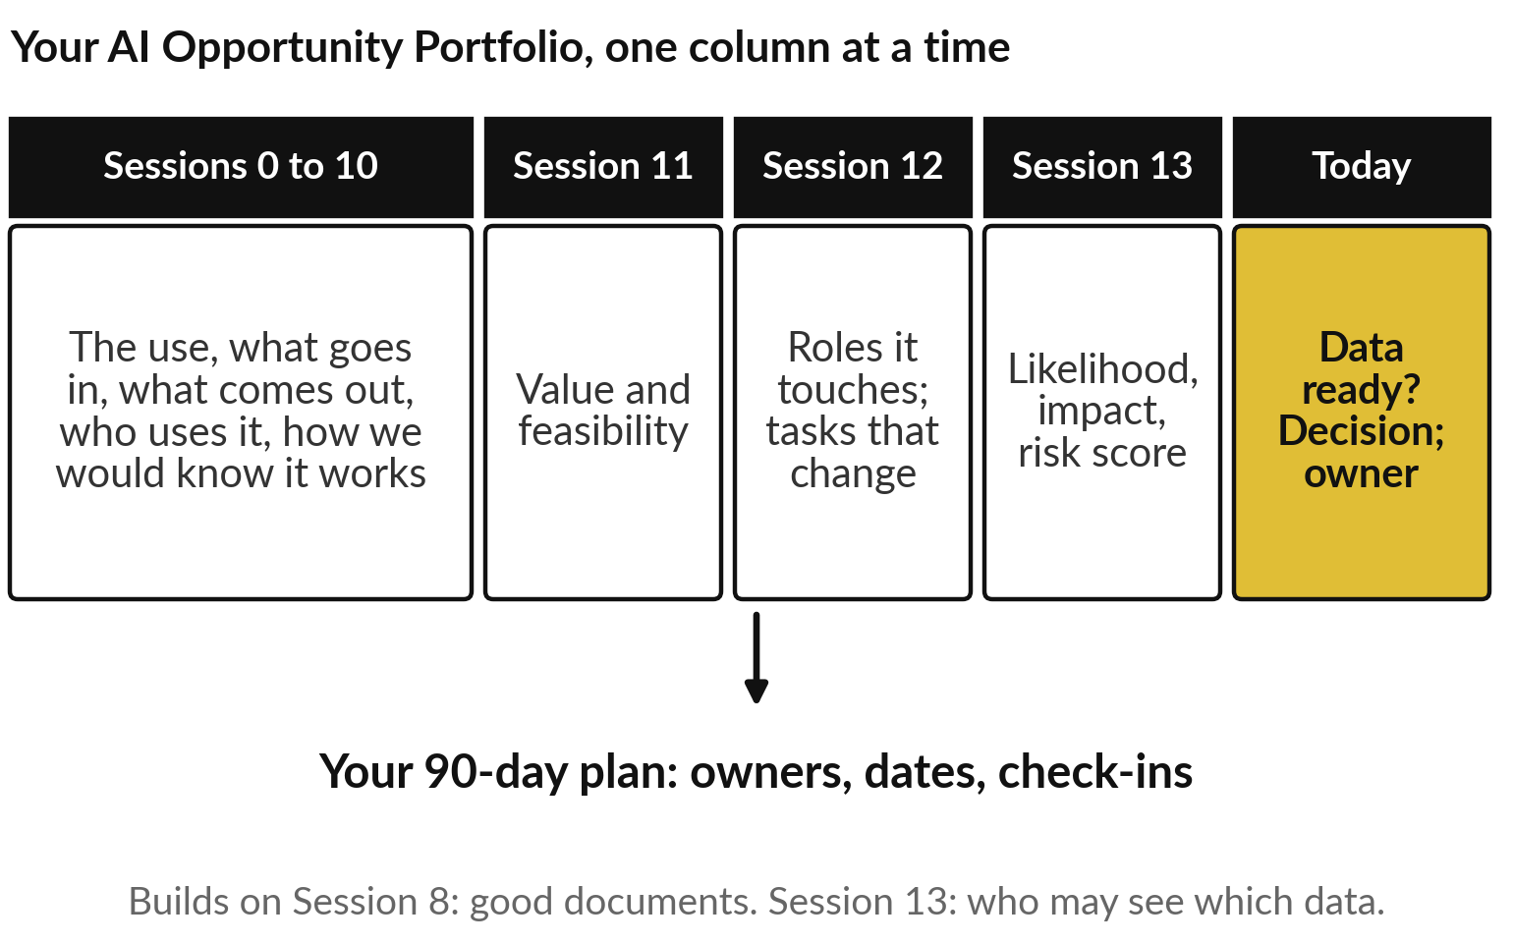
Your portfolio gains its last
column today, and becomes a plan
The last column asks whether the data is ready.
Then every entry gets a decision.
The decisions become your ninety-day plan.
Notes:
Those six words serve the page you have been building since Session 0. Your AI Opportunity Portfolio began with candidate uses: what goes in, what comes out, who uses it, and how you would know it works. Session 11 added value and feasibility, Session 12 the people each use touches, and Session 13 the risk.
Today adds the last column: is the data ready?
Then every entry gets a decision, and the decisions become your ninety-day plan. Two earlier lessons point here. Session 8 showed that an assistant answers only as well as its documents, and Session 13 sorted data by who may see it. A case from home shows what happens when the data is not ready.

Slide 8
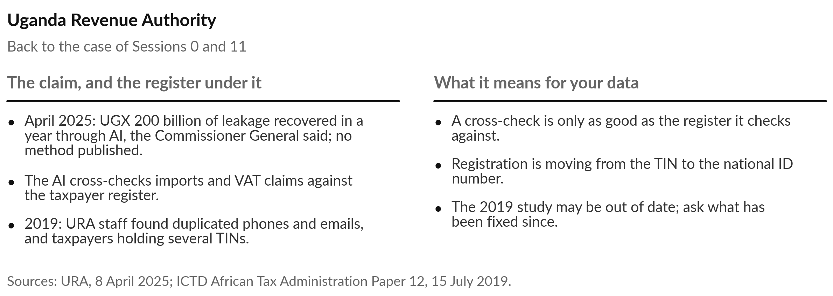
URA’s AI claim rests on a taxpayer register
its own staff found needed cleaning
Today’s question: is our data ready, and what do we do in the next 90 days?
Notes:
The course closes where it opened. You met the Uganda Revenue Authority in Session 0, and again in Session 11, where I promised we would come back to its data. In brief: URA cross-checks records such as imports and VAT claims, and in April 2025 the Commissioner General said it recovered 200 billion shillings of leakage in one year through AI, a speech claim with no published method.
The part that matters today came earlier. In 2019 URA’s own staff studied the taxpayer register and found duplicated phone numbers and emails, and taxpayers holding several tax numbers. A cross-check is only as good as the register it checks against, though that study may be out of date now.
Today’s question is the same one, put to your organisation: is our data ready, and what do we do in the next ninety days?

Slide 9
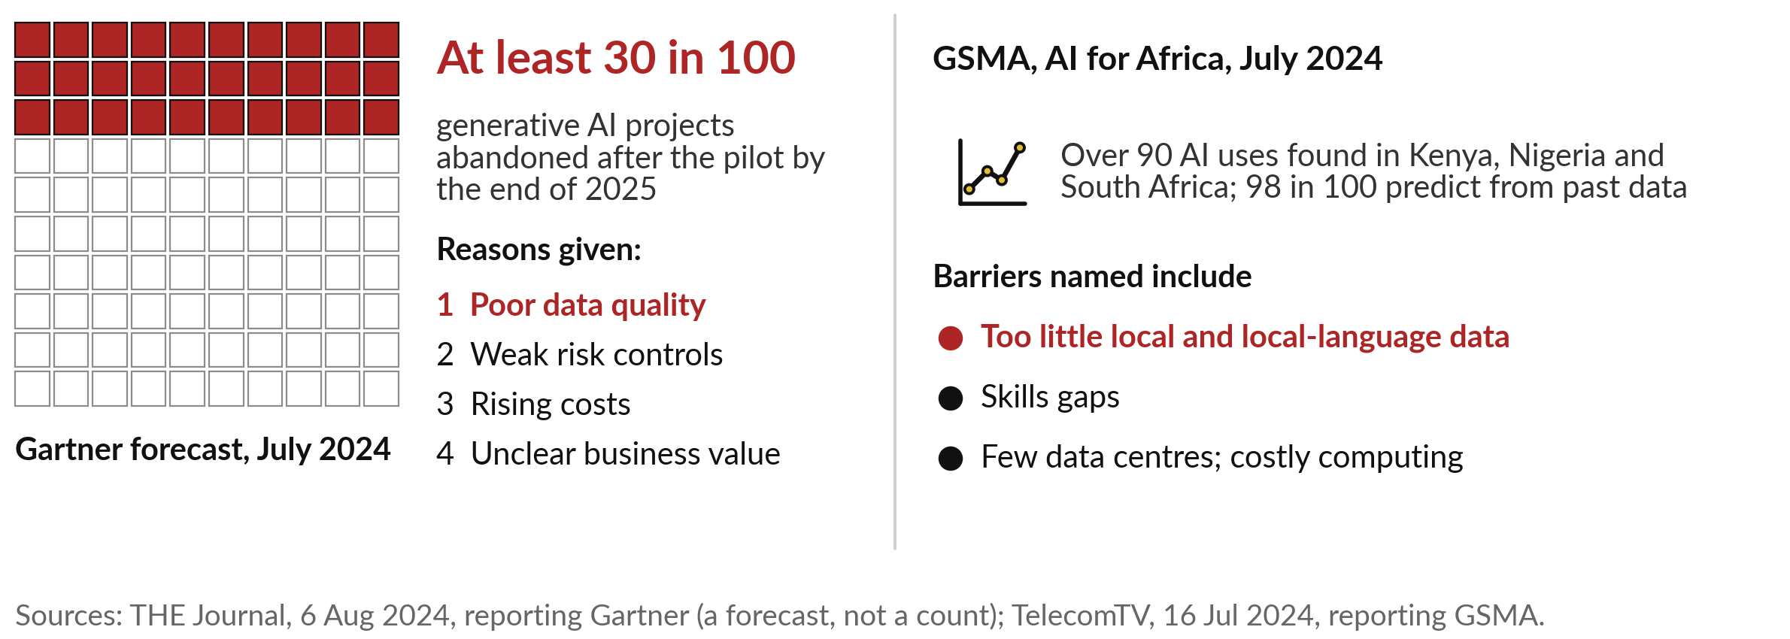
Gartner expected at least 30 in 100 pilots to
be dropped, and named poor data quality first
A forecast and a survey of uses, both from 2024. Data is the common thread.
Notes:
URA is not alone, and the wider evidence explains why we spend our last session on data. In July 2024 Gartner forecast that at least 30 in every 100 generative AI projects would be abandoned after the pilot by the end of 2025. The first reason it gave was poor data quality, then weak risk controls, rising costs and unclear business value.
That was a forecast, and I found no later check of it. In the same month the GSMA counted over ninety AI uses in Kenya, Nigeria and South Africa. Nearly all of them predict from past data, as in Session 2, and among the barriers it named was too little local data. The first question for you is therefore what data you hold.

Slide 10
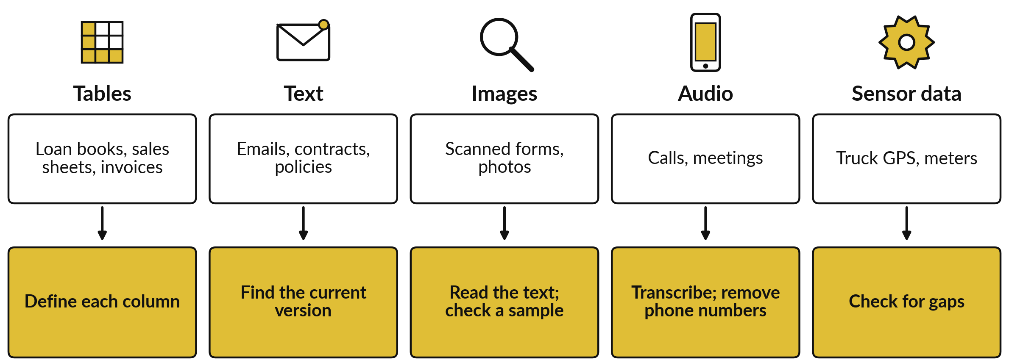
Five kinds of data, and the first
step that makes each one ready
Tables are structured data; text, images, audio and sensor readings are unstructured.
Notes:
Every organisation holds five kinds of data, and each has its own first step. Tables are rows and named columns, such as a loan book or a sales sheet; the industry calls them structured data. The first step is to write down what each column means. Text, images, audio and sensor readings are unstructured.
For text, find the current version of each document. For a scanned form, the text must first be read from the picture, which the industry calls OCR, optical character recognition, as in Session 1; then check a sample by eye. For calls, transcribe them and remove phone numbers.
For sensors, such as truck GPS, check for gaps. Most of you hold far more of one kind than the others, and that is where to start.

Slide 11
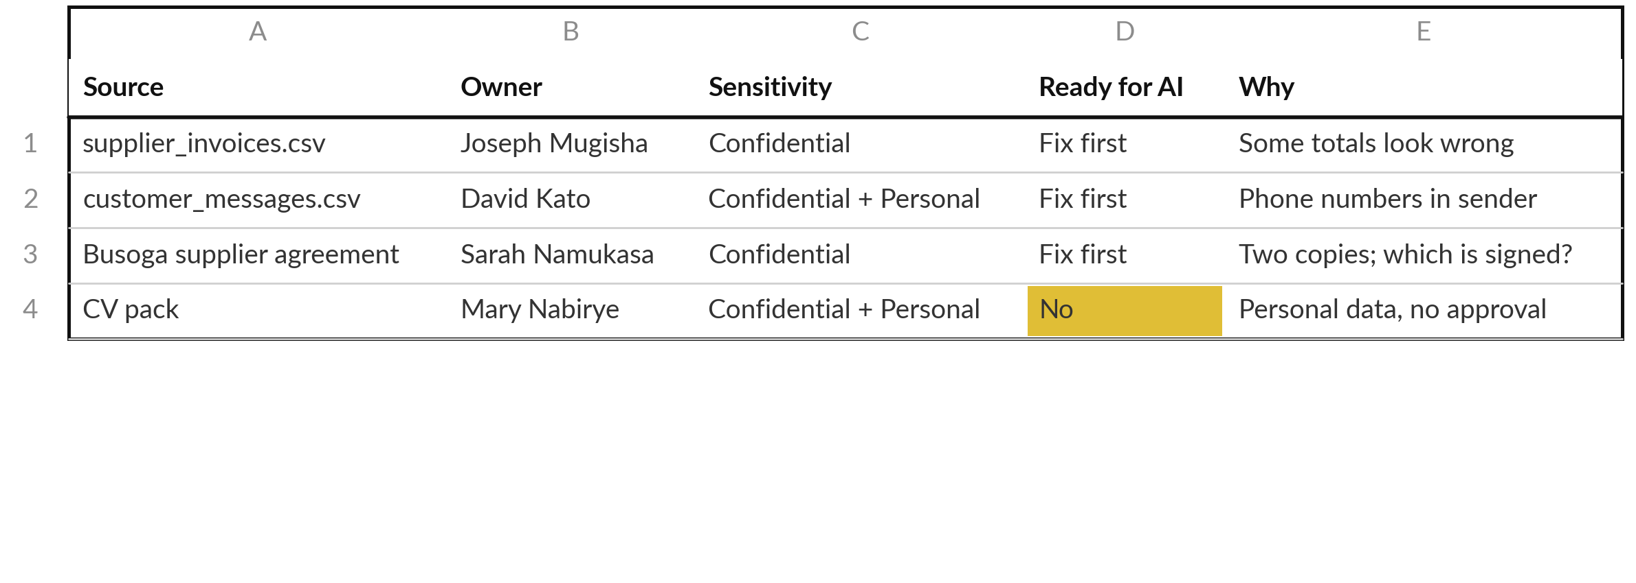
A data inventory lists every source with its
owner, who may see it, and whether it is ready
Nile Valley Foods is fictional. Sensitivity uses the labels of Session 13.
Notes:
Knowing the kinds, you write them down, one row per source. That list is the data inventory, and here are four rows for Nile Valley Foods, our fictional distributor in Jinja. Each source has one named owner, the data owner from our words. Sensitivity uses the labels from Session 13.
The last columns give a verdict: is it ready for AI?
Yes, fix first, or no. The invoice file is confidential and some totals look wrong. The customer messages hold phone numbers, so they are personal as well. The supplier agreement exists in two copies, and nothing says which one was signed. The CV pack is personal data with no approval for any AI tool, so the answer is no.
How wrong is the invoice file? We count.

Slide 12
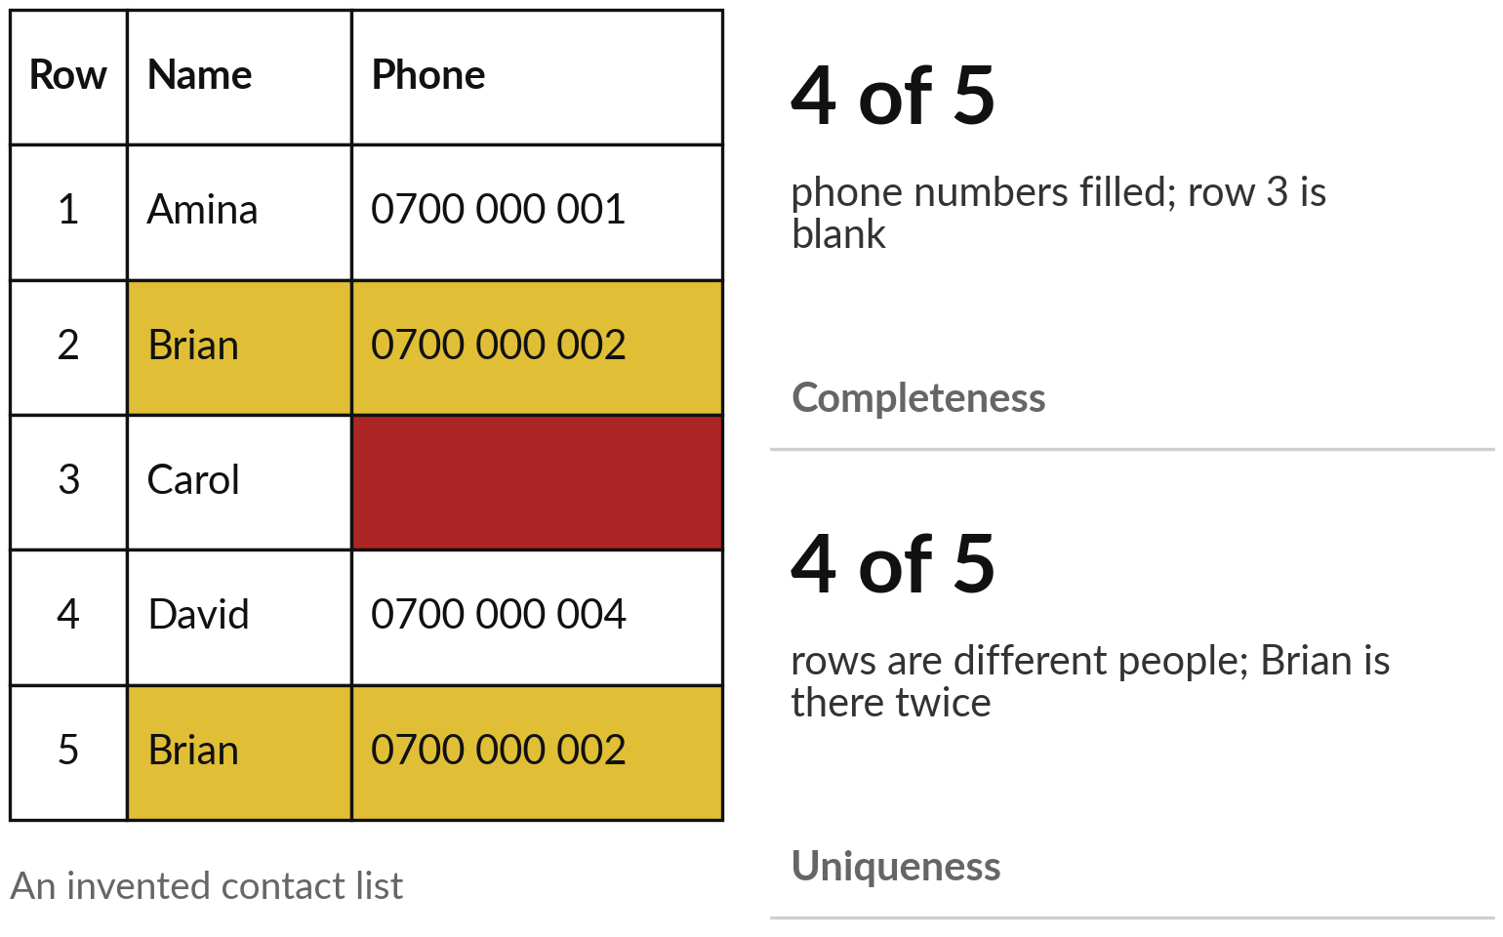
Check quality by counting: 4 of 5 phone
numbers filled, 4 different people in 5 rows
A count beats an opinion about whether data is good.
A doubled contact is a nuisance; a doubled invoice can be paid twice.
Notes:
Counting is how you judge quality, and a list of five contacts shows it. Look at the phone column. Five rows, four numbers, and Carol’s is blank: 4 of 5 filled. The industry calls that check completeness. Now the names. Brian appears in row two and again in row five, with the same phone, so the five rows hold four different people.
That check is uniqueness: is each thing recorded once?
A doubled contact is a nuisance; a doubled invoice can be paid twice. There are six standard checks in all, called data quality dimensions, and the demonstration shows each one counted on the Nile Valley Foods files. Counts tell you about one file. To judge a whole organisation, you need a wider tool.

Slide 13
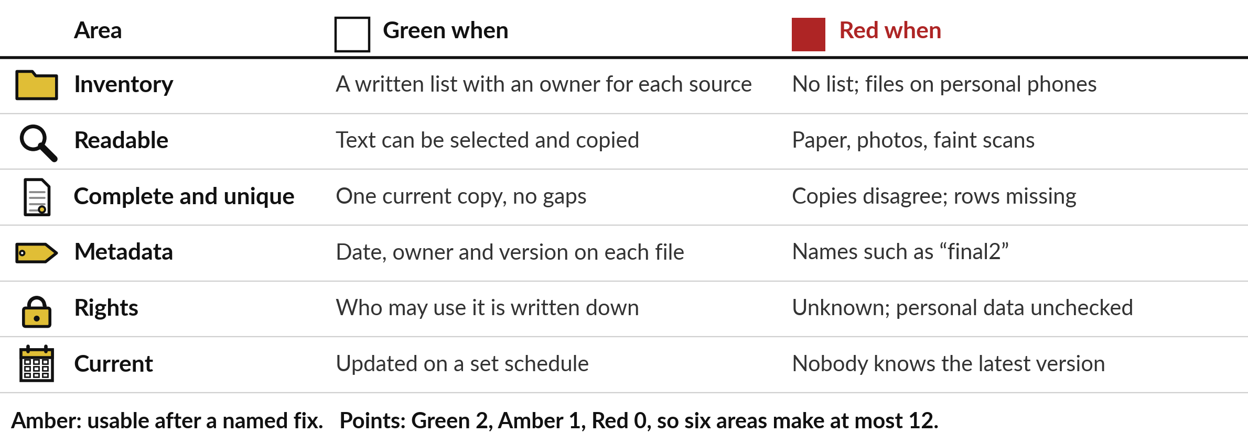
The readiness scorecard rates six areas
Green, Amber or Red by a written rule
From the Information Inventory template. Amber means usable after a named fix.
Notes:
That wider tool is the readiness scorecard, in the Information Inventory template. It rates six areas by a written rule. Inventory: is there a list with an owner for each source?
Readable: can the text be selected and copied, or is it paper and faint scans?
Complete and unique: one current copy, no gaps, the two counts we just made. Metadata, which means data about the data: does each file carry a date, an owner and a version?
Rights: is it written down who may use it?
Current: is it updated on a schedule?
Green when the rule is met, Red when the right-hand column describes you, Amber when a named fix would make it usable. Green earns two points, Amber one, Red none, so twelve at most.

Slide 14
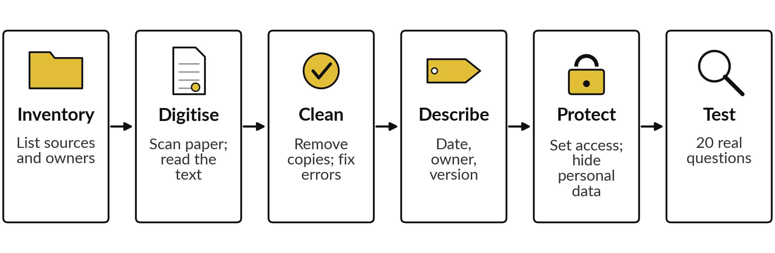
Six steps turn scattered files
into data an AI tool can use
Start with one folder and one use. Test it, then widen.
Notes:
The scorecard shows what is weak; six steps fix it, in this order. Inventory: list every source and its owner. Digitise: scan paper and read the text. Clean: remove duplicates and fix errors, which raises completeness and uniqueness. Describe: add the date, owner and version, and note where each file came from.
Protect: set who may see what, and hide personal data in the copies a tool will use. Test: ask twenty real questions whose answers you know, like the test set of Session 9, and count right, wrong and invented answers. Skipping the test is the usual mistake. And do not try to clean everything first: start with one folder and one use.
Organisations in every one of our industries are working through the same steps.

Slide 15
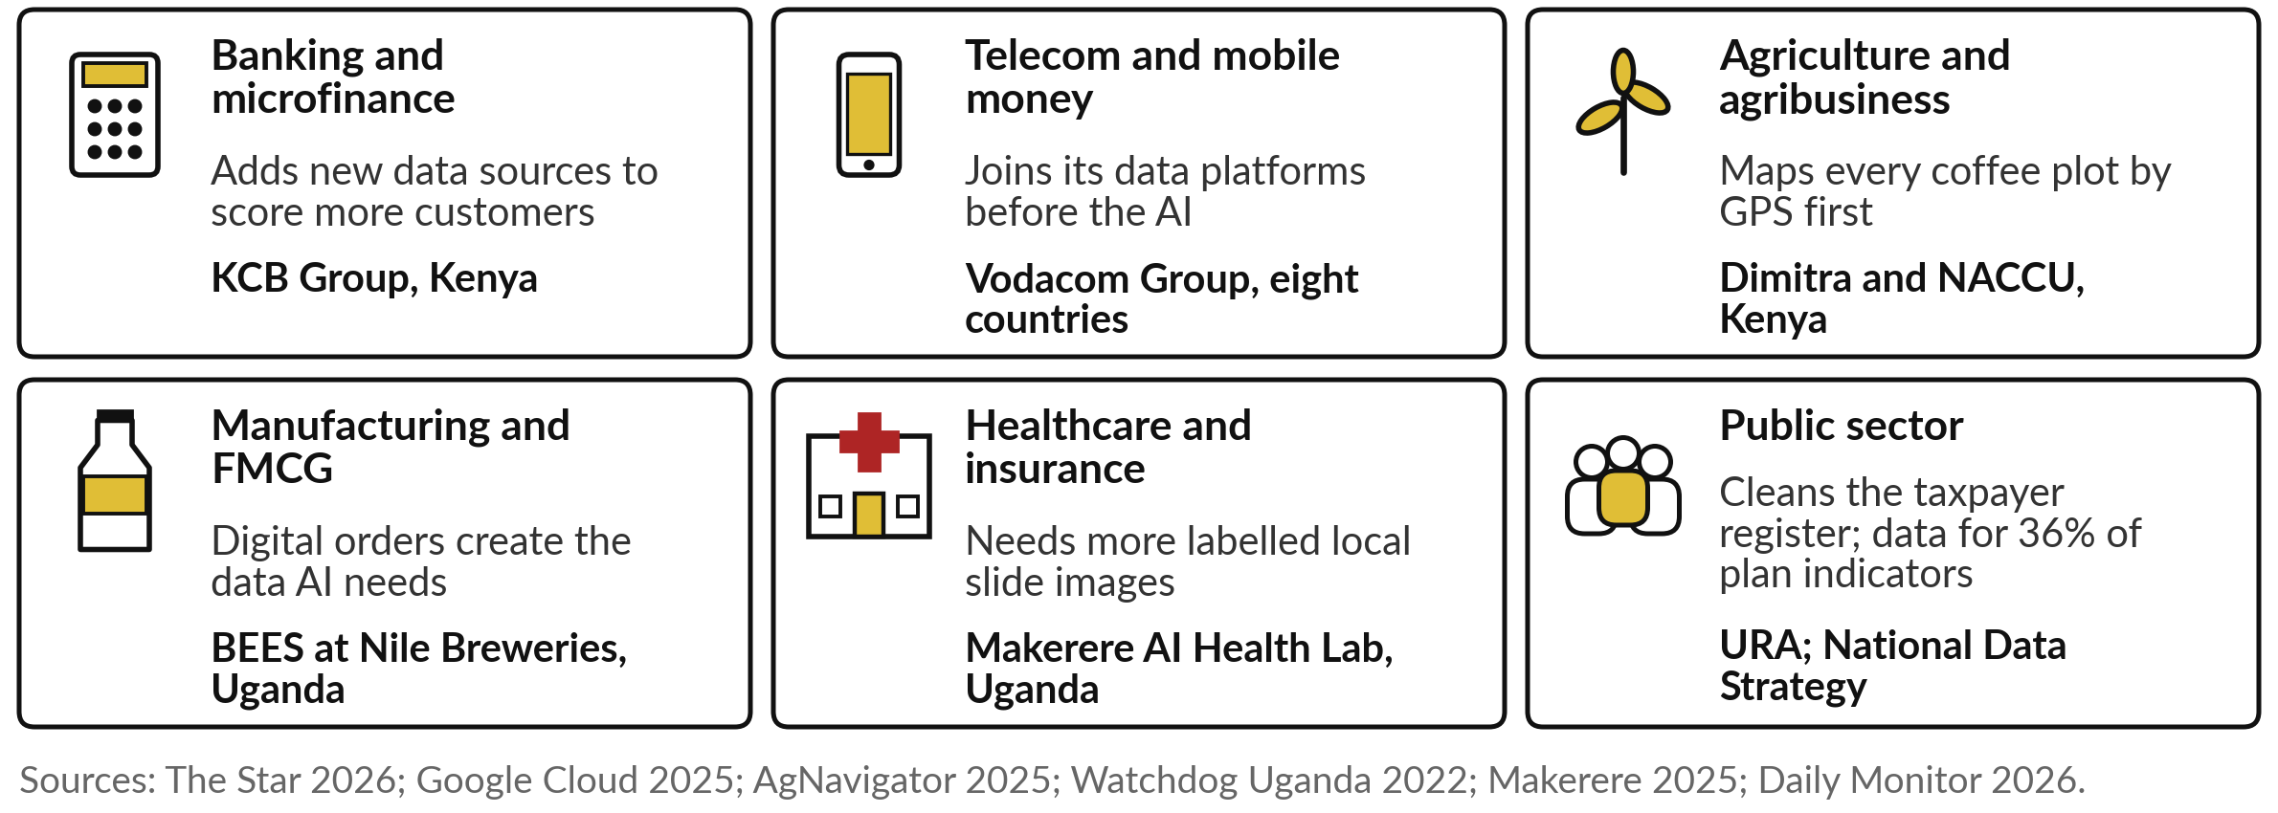
In all six industries, the data
work comes before the AI
Most of these are plans and announcements; KCB’s is the one with customers already scored.
Notes:
The same order shows up in all six of our industries. In banking, KCB Group in Kenya added payment and Hustler Fund repayment data to score more customers for mobile loans. In telecom, Vodacom is joining its data platforms before it applies AI. In agriculture, Dimitra and Kenya’s coffee cooperative union, NACCU, plan to map every farmer’s plot by GPS to meet European deforestation rules, before any analysis.
In FMCG, Nile Breweries’ ordering app creates the order records that suggestions need. In health, the Makerere AI Health Lab’s malaria tool needs more labelled local slide images. And in the public sector, URA cleans its register while government counts how little data it has. Find your tile; we start with the telecom story.

Slide 16
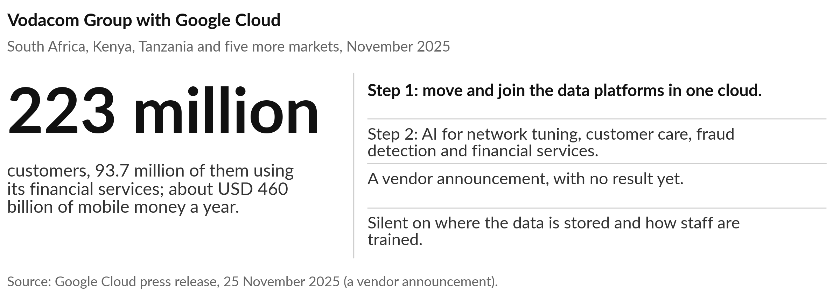
Vodacom is joining its data platforms first,
then applying AI across eight countries
The data platform comes before the AI.
Notes:
The first story is the largest. Vodacom Group, which includes Safaricom, serves over 223 million customers in eight countries, and 93.7 million of them use its financial services. Its data sat on separate platforms. In November 2025 it announced a multi-year deal with Google Cloud. Step one moves and joins the data platforms.
Only then come the AI uses: tuning the network, personal customer care, fraud detection and new financial services. It is a vendor press release, with no result yet, and it says nothing about where the data will be stored, which Session 6 and Session 13 taught you to ask, or how staff will be trained. The lesson is the order. A government faces the same order.

Slide 17
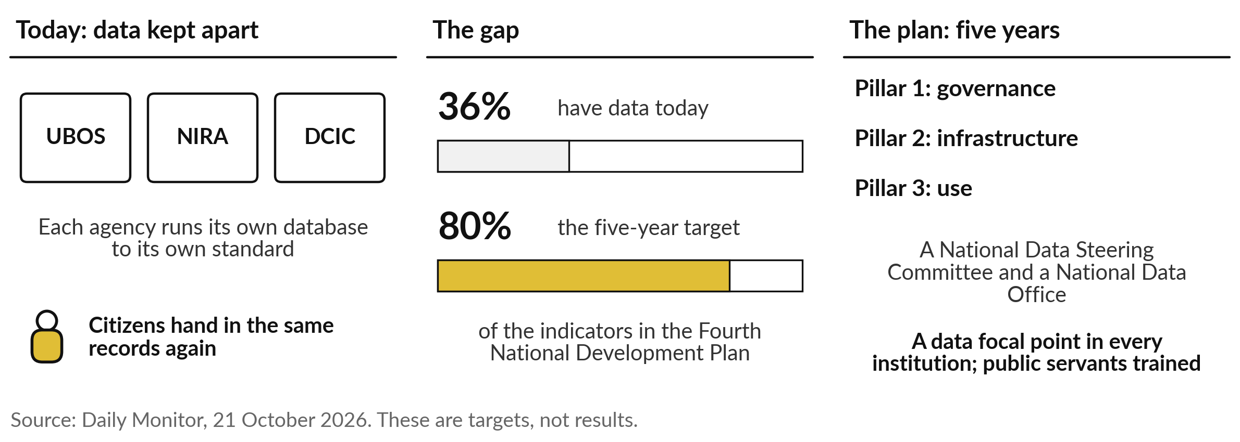
Uganda has data for 36% of its plan indicators
today, and aims for 80% in five years
Launched in October 2026 as groundwork for the national AI strategy.
Notes:
The second story is our own government’s. In October 2026 the Ministry of ICT and National Guidance, with UN Global Pulse and UNDP, launched a five-year National Data Strategy, described as groundwork for the national AI strategy. Its baseline survey found data for only 36 per cent of the indicators in the Fourth National Development Plan.
The target is 80 per cent in five years. Agencies such as the Bureau of Statistics, the national identity authority and immigration run separate databases with different standards, so citizens hand in the same records again. The plan has three pillars, a steering committee, a data office, and a data focal point in every institution.
These are targets, and the AI strategy itself is still to come.

Slide 18
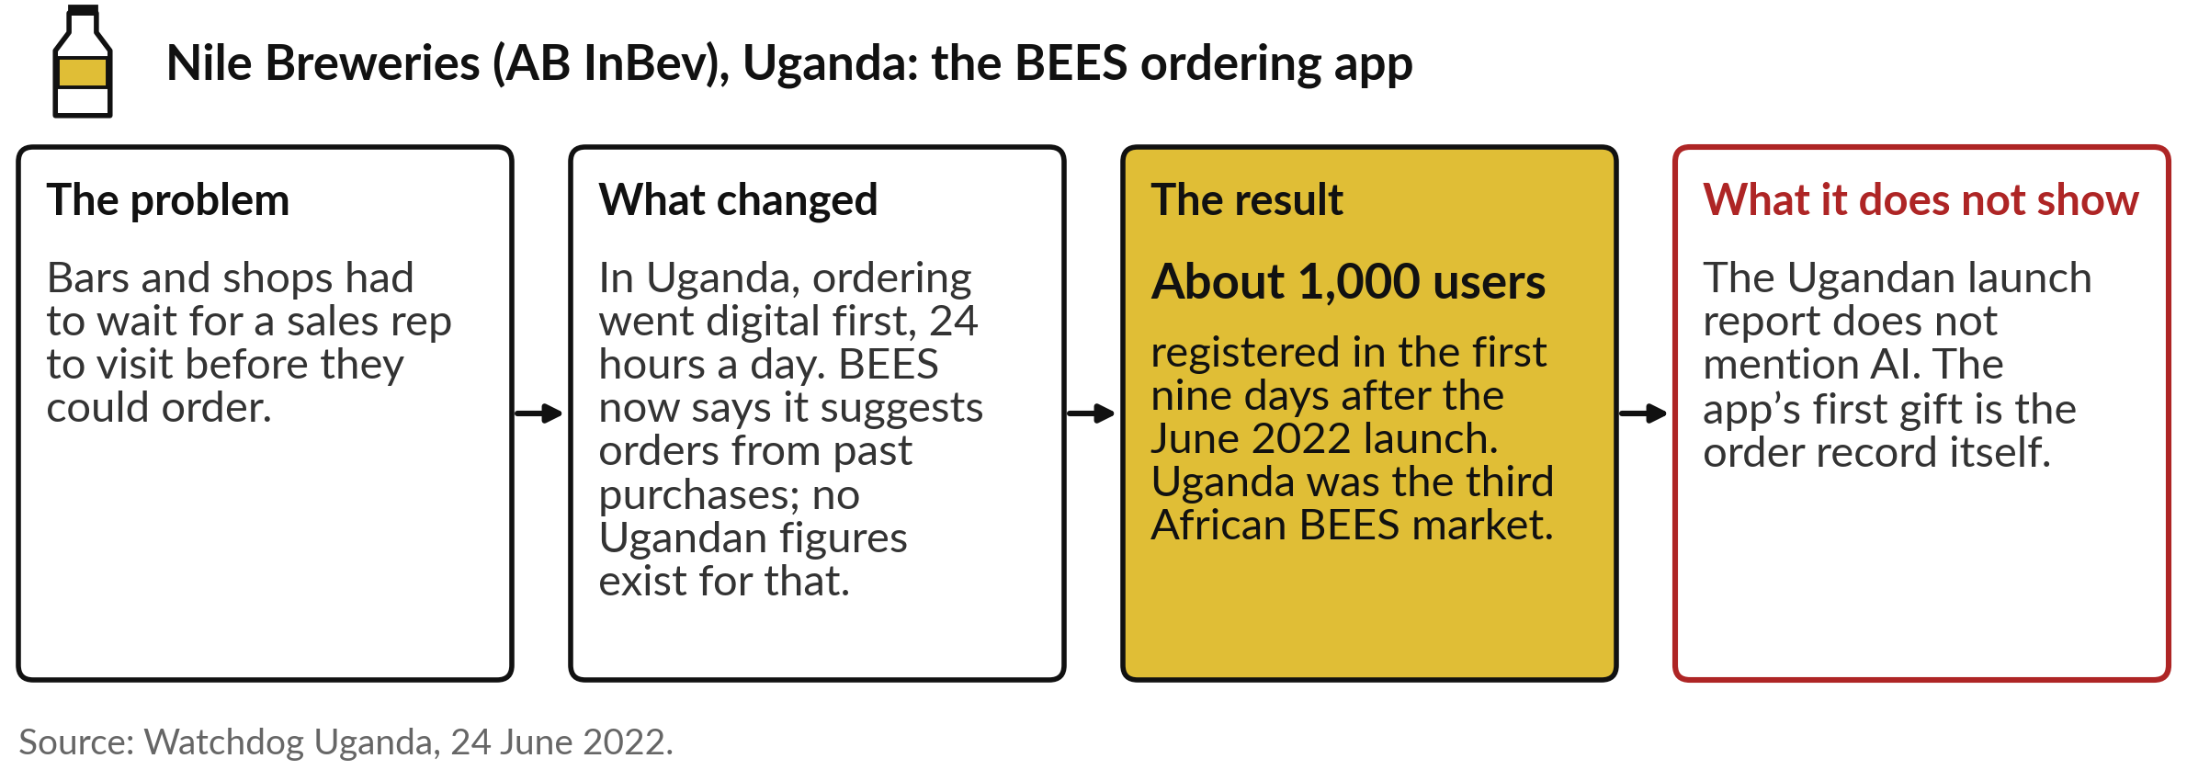
Digital ordering at Nile Breweries creates
the data that AI suggestions need
Every digital order is a row of data that did not exist before.
Notes:
The third story is a Ugandan brewer, and it shows where data comes from. In June 2022 Nile Breweries launched BEES, AB InBev’s ordering app. Bars and shops no longer wait for a sales rep: they order at any hour, see deals and arrange delivery. About 1,000 users registered in the first nine days.
Yet the Ugandan launch report does not mention AI at all. BEES now says it suggests orders from past purchases, like the Coca-Cola app of Sessions 2 and 11, but there are no Ugandan figures for that. For a leader the prize is the order record: every digital order is data that the paper order book never gave you. Data you already hold has faults, and they can be counted.

Slide 19
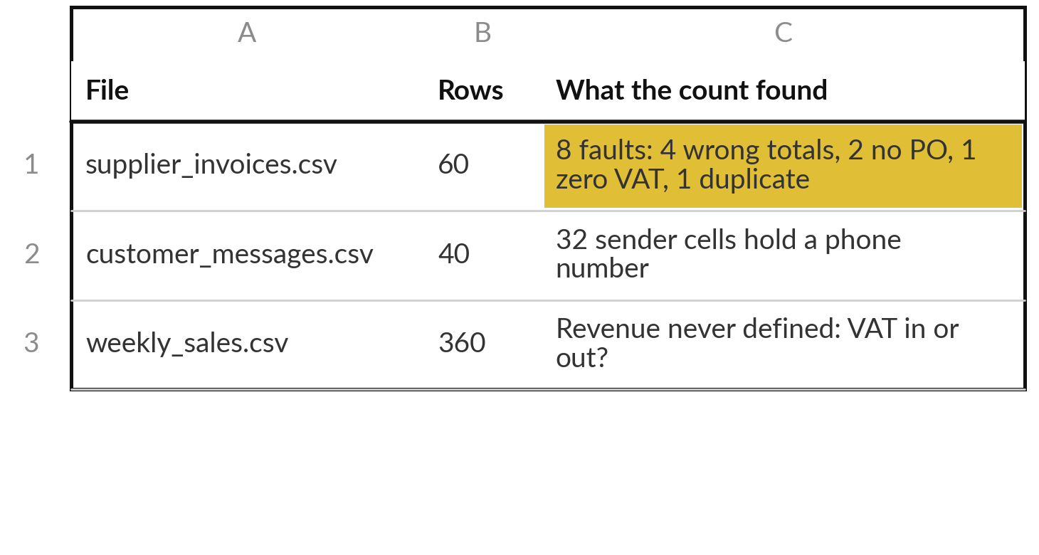
A short script counts the faults
in the Nile Valley Foods files
I will show
Watch for
Exact counts, from a plain script
Personal data hiding in an ordinary column
A file can be readable and still unclear
Recorded run, 6 November 2026; no AI model
Notes:
Now the counting, on three files of Nile Valley Foods, our fictional company. This is a recorded run from 6 November 2026: a short Python script, one run, and no AI model, because counting needs none. Watch for exact counts, for personal data in an ordinary column, and for a file that reads well and is still unclear.
The invoice file has sixty rows and eight faults: four totals that do not add up, two invoices with no purchase order number, one line with zero VAT from a supplier that charges VAT on its other invoices, and one invoice entered twice. The customer messages have forty rows, and thirty-two sender cells hold a phone number.
The sales file has 360 rows and never says whether revenue includes VAT. The script can be re-run on your own files.

Slide 20
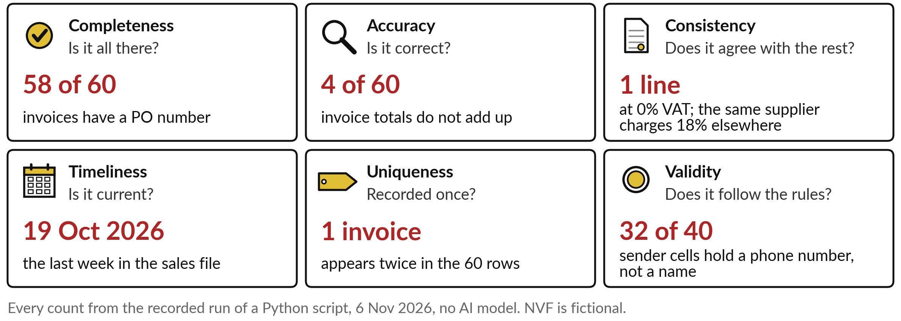
The six quality checks, each a
count on the Nile Valley Foods files
Name the check, then count it. Each count becomes a fix with an owner.
Notes:
Those counts map onto the six standard checks, the data quality dimensions, and every number here comes from the same recorded run. Completeness: 58 of 60 invoices have a purchase order number, the reference that matches an invoice to its order. Accuracy: 4 of 60 totals do not add up.
Consistency: one Lakeside Logistics line shows zero VAT, while its other invoices charge 18 per cent, so someone must check it. Timeliness: the sales file stops at the week of 19 October; is that recent enough?
Uniqueness: one invoice appears twice, enough to pay a supplier twice. Validity: 32 of 40 sender cells hold a phone number, personal data where a name should be. The label matters less than naming the fault and counting it, because each count becomes a fix with an owner. Now a score for the whole company.

Slide 21
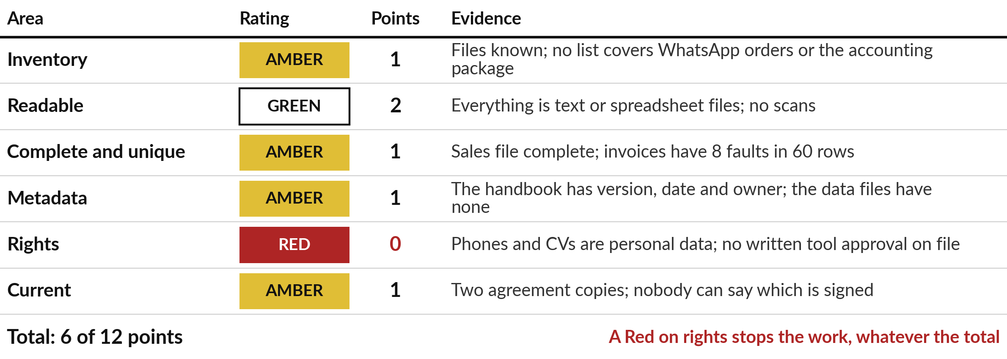
Nile Valley Foods scores 6 of 12,
and the Red on rights stops the work
Fictional company; ratings as in the Information Inventory template.
Notes:
Read the Nile Valley Foods scorecard from the top. Inventory is Amber, one point: the files are known, but nothing lists the WhatsApp orders. Readable is Green, two points: everything is text or spreadsheet files. Complete and unique is Amber, because of the eight invoice faults. Metadata is Amber: only the staff handbook carries a date, an owner and a version.
Rights is Red, no points, because the phone numbers and CVs are personal data and no tool has written approval. Current is Amber: there are two copies of the supplier agreement and nobody can say which is signed. Six of twelve. Every rating carries one line of evidence, because a rating without evidence is an opinion.
And a Red on rights stops the work until someone with authority, and your lawyer, has settled it. After the break, you score your own.

Slide 22
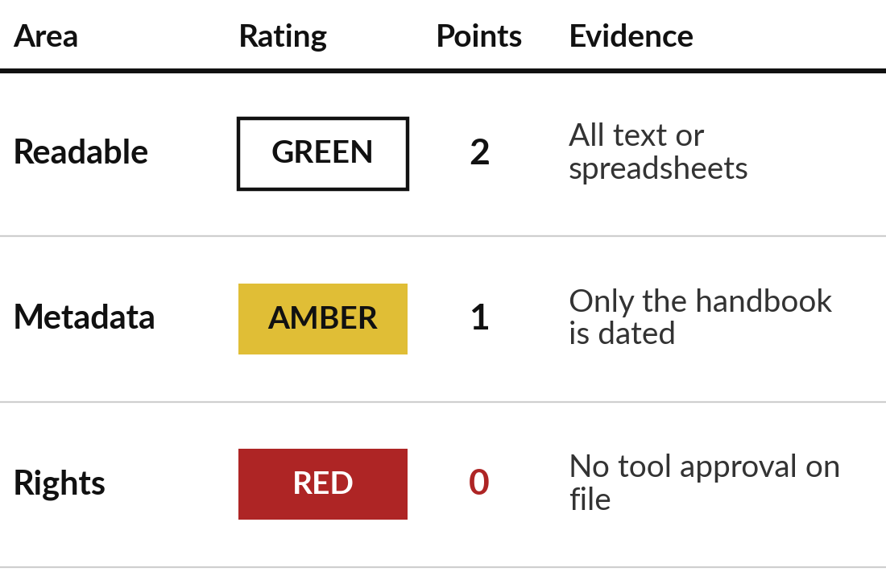
List your sources, then score
your own organisation out of 12
15 minutes
Hands-on: your organisation
Build your inventory and your readiness scorecard.
Information Inventory, sheet Inventory: at least six sources, each with an owner.
Label each by sensitivity, and mark Ready for AI: Yes, Fix first or No.
Sheet Readiness scorecard: rate the six areas, one line of evidence each.
Read your total out of 12 and pick your top three gaps.
You keep: An inventory, six ratings with evidence, a total and three gaps.
Notes:
Welcome back. The next hour is yours, and it starts with your sources. You have fifteen minutes, and I walk round while you work. Open the Information Inventory and list at least six sources that an AI tool might touch, each with its owner. Include the awkward ones: WhatsApp orders, paper files, a spreadsheet on one laptop.
If you do not know the owner, write unknown; that is a finding. Label each by sensitivity and mark whether it is ready. Then move to the Readiness scorecard sheet and rate the six areas, one line of evidence for each. The sheet adds the points. Finish by picking your top three gaps.
Be strict on rights: if nobody knows who may use a source, it is Red.

Slide 23
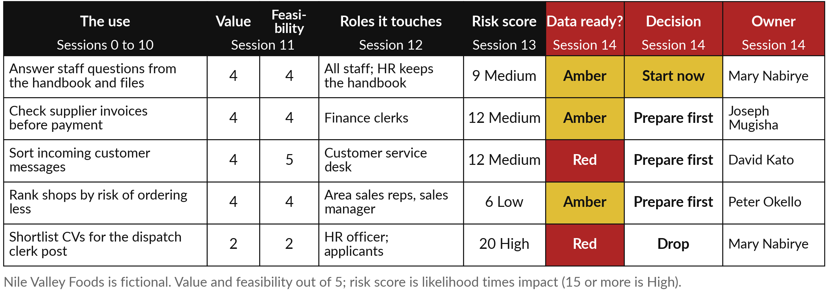
In the final Nile Valley Foods portfolio,
one entry starts now and one is dropped
Each column came from a session. The last three come from today.
Notes:
Your scores now feed the page you have built all course. The final portfolio for Nile Valley Foods has five entries, with the columns of the portfolio’s last sheet. Value and feasibility came from Session 11, the roles each use touches from Session 12, and the risk score, how likely times how bad, from Session 13.
Today adds whether the data is ready, a decision from four, start now, prepare first, later or drop, and one owner. Answering staff questions from the handbook starts now, because its documents are nearly ready. Three uses are worth doing but their data is not ready, so they prepare first.
The CV shortlist is dropped: personal data, a High risk, and the kind of use where hidden bias has done harm before. One use starts. That restraint is the decision.

Slide 24
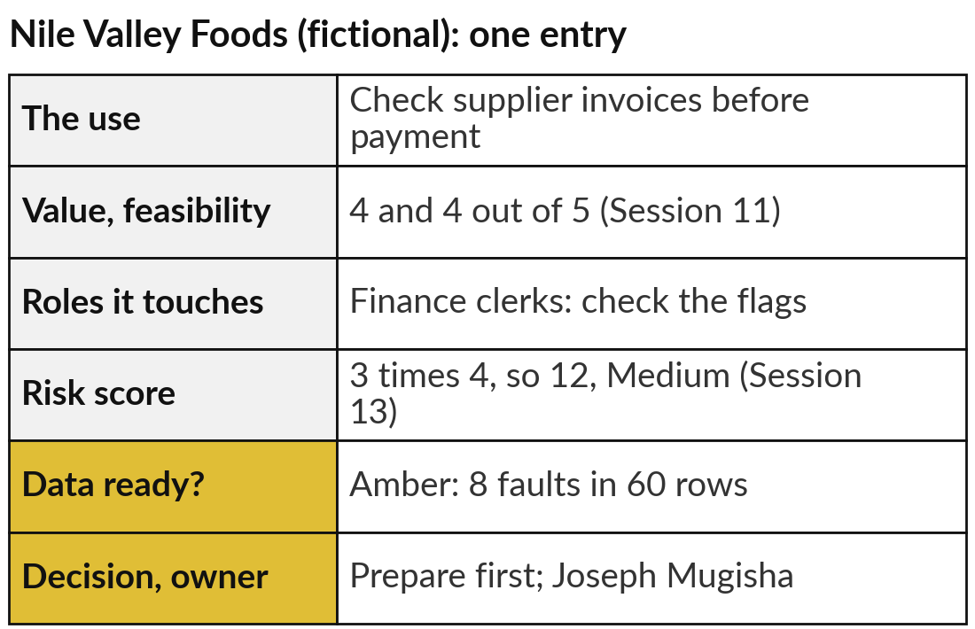
Finish your AI Opportunity Portfolio: data
readiness, a decision and an owner for every entry
15 minutes
Hands-on: your portfolio
Complete the sheet People, risk, data.
For each entry, write Data ready? Green, Amber or Red, from your scorecard.
Check value, feasibility, people and risk from Sessions 11 to 13.
Decide: Start now, Prepare first, Later or Drop.
Name one owner. Choose only one entry to start now.
You keep: A final portfolio: every entry decided, one to start now.
Notes:
Now finish your own portfolio. Fifteen minutes, and I walk round. Open the AI Opportunity Portfolio, sheet People, risk, data. For each entry, write whether its data is ready, Green, Amber or Red, using the scorecard you just built. Check the earlier columns: value and feasibility from Session 11, people from Session 12, risk from Session 13.
Then decide. Start now if the value is high, the data is ready and the risk is under control. Prepare first if it is worth doing but the data is not ready. Later if it can wait. Drop if the risk or the data rules it out. Name one owner for each, and choose only one entry to start now. The example shows one Nile Valley Foods entry.

Slide 25
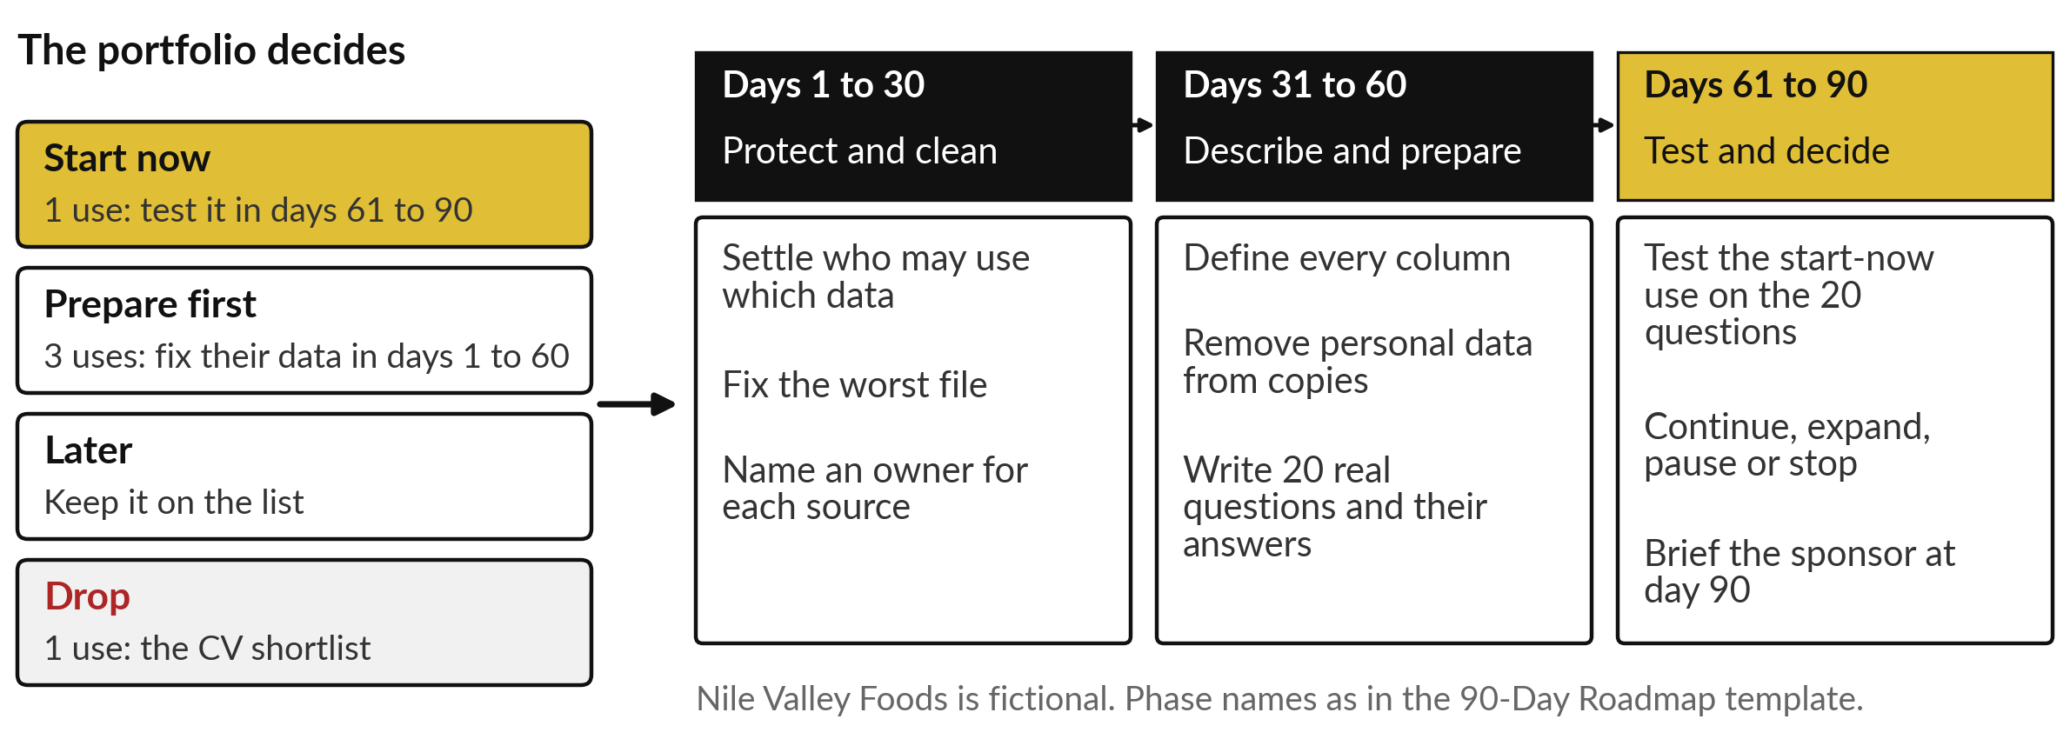
The portfolio becomes the 90-day plan:
prepare the data first, then test one use
Protect and clean, describe and prepare, test and decide: the three phases of the 90-Day Roadmap.
Notes:
Your decisions now set the shape of the next ninety days. Start-now entries are tested in the last thirty days. Prepare-first entries get their data fixed in the first sixty. Later entries stay on the list, and dropped ones leave it. The 90-Day Roadmap template splits the time into three phases.
Days one to thirty: protect and clean, which means settling who may use which data, fixing the worst file and naming an owner for each source. Days thirty-one to sixty: describe and prepare, defining every column, removing personal data from copies and writing twenty real questions with their answers.
Days sixty-one to ninety: test the start-now use, then decide to continue, expand, pause or stop, and brief your sponsor. Drawn as a chart, the plan shows what has to wait for what.

Slide 26
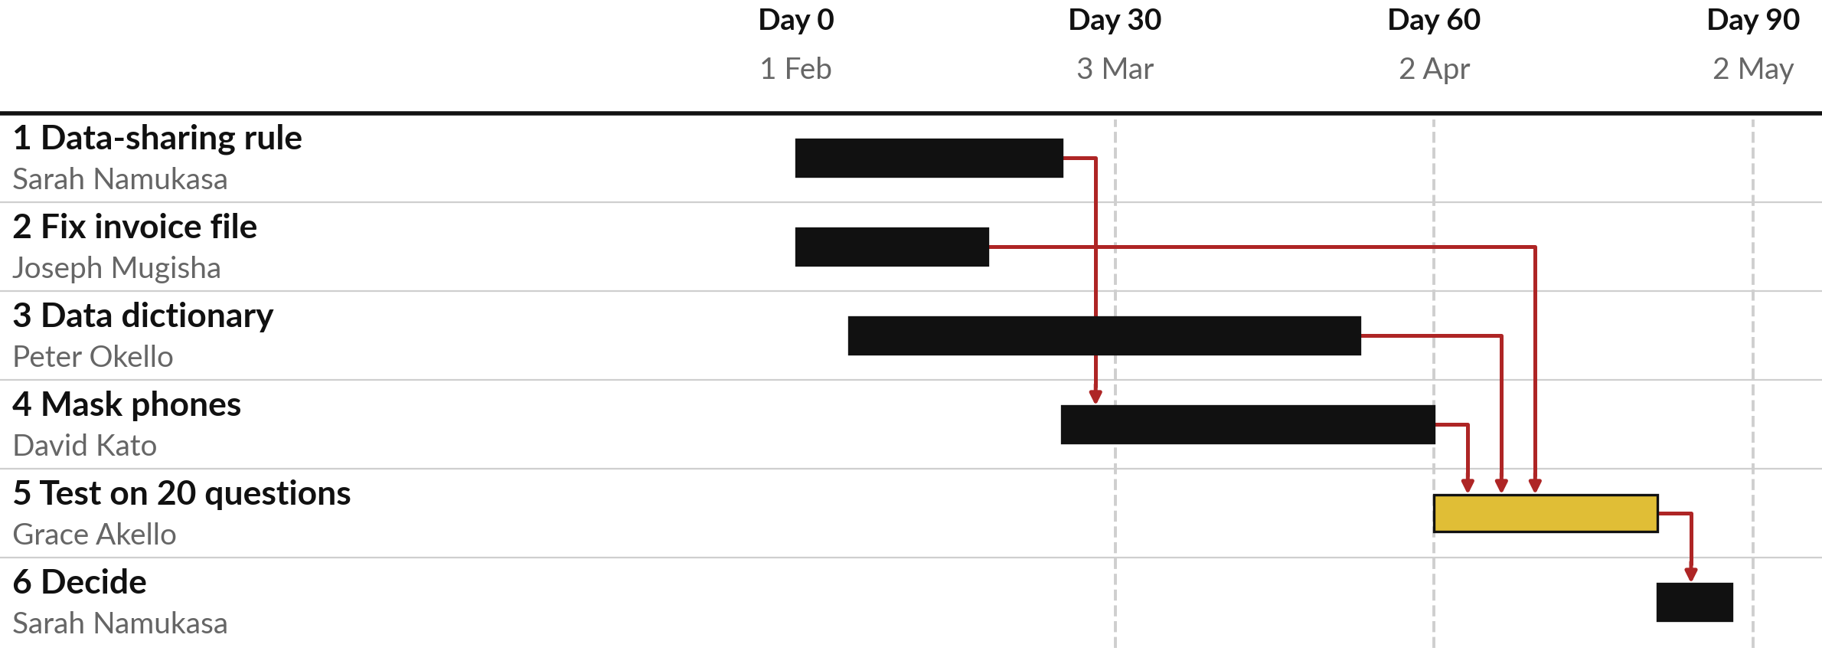
In the Nile Valley Foods roadmap, rights
and cleaning come before the test
Fictional plan starting 1 February 2027. Red arrows show what waits; gold is the test.
Notes:
Planning a trip, you get the visa before the ticket. A roadmap puts actions in that order. This is the Nile Valley Foods roadmap, from the 90-Day Roadmap template, starting on the first of February. Each bar is one action with one owner. The dates at day thirty, sixty and ninety are milestones, the dated checkpoints from our words.
The gold bar is the test on twenty questions. It waits for the invoice file to be fixed, the data dictionary to be written and the phone numbers to be masked, and masking waits for the data-sharing rule, because rights is the Red area. The red arrows show those waits.
Test before you settle rights and you test data you may not be allowed to use.

Slide 27
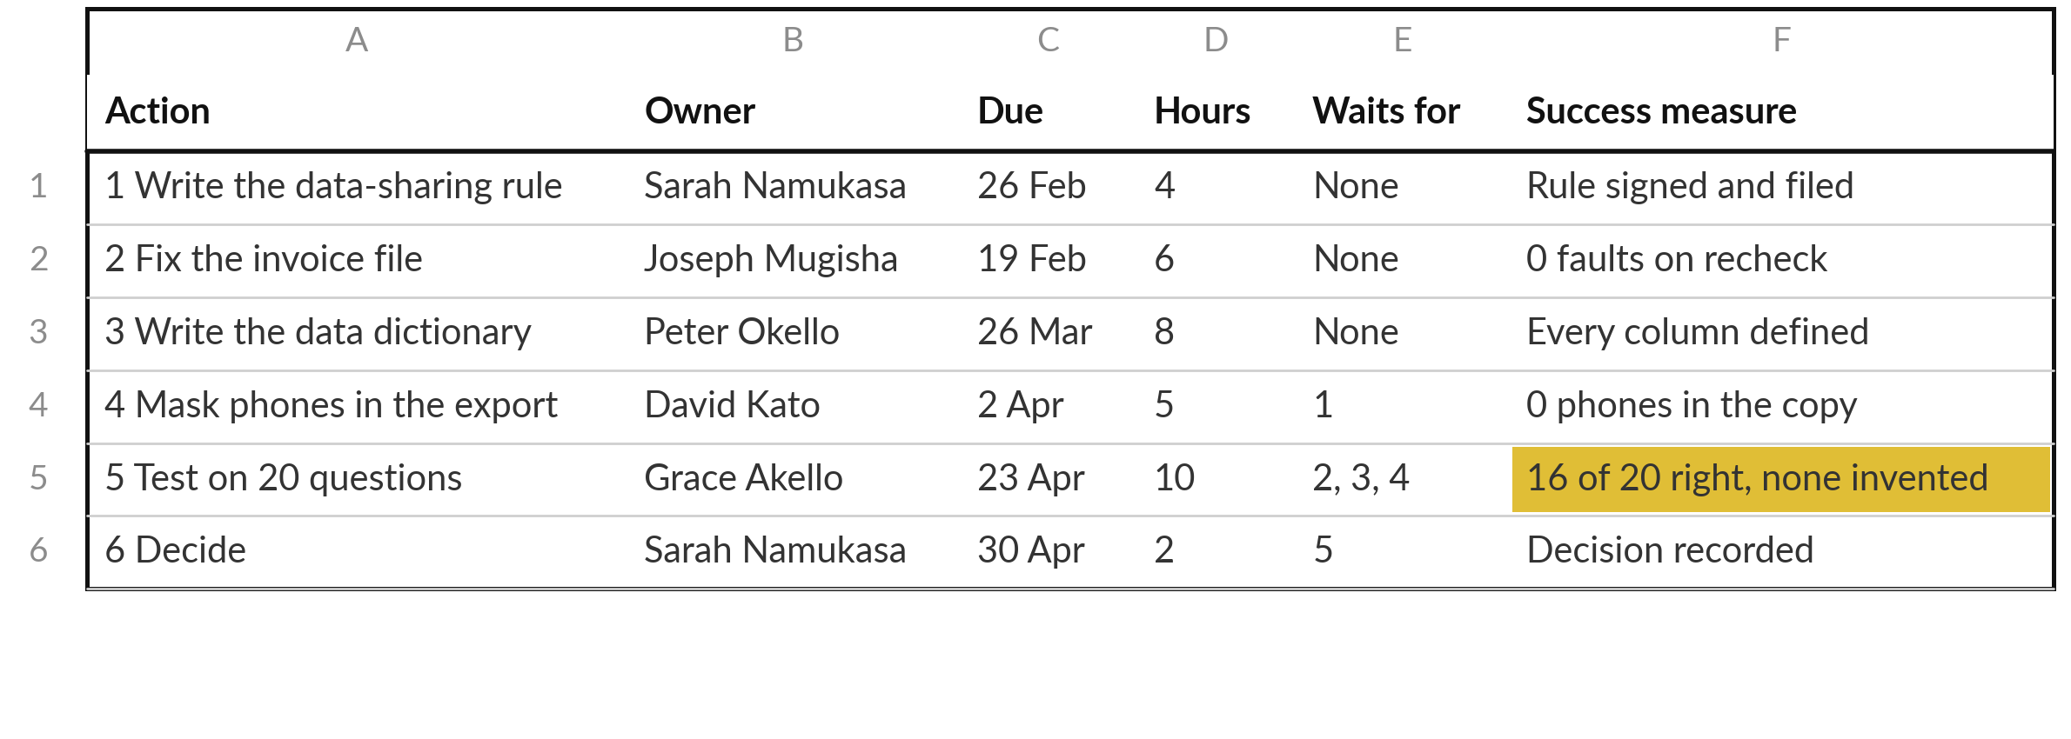
Every roadmap line has one owner, a due
date, the hours and a success measure
Fictional values from the template. 35 hours in all, across five people.
Notes:
Behind each bar sits one line, with the columns of the Roadmap sheet: the action, one owner, a due date, the hours, what it waits for, and a success measure. A success measure is a number that someone else can check. Better data quality is a wish. Zero faults on recheck by the nineteenth of February is a measure.
Sixteen of twenty test questions right, with none invented, is a measure, and it is written before the test is run. The hours are estimates, thirty-five in all, across five people, so the plan is small enough to finish beside normal work. Now you build yours.

Slide 28
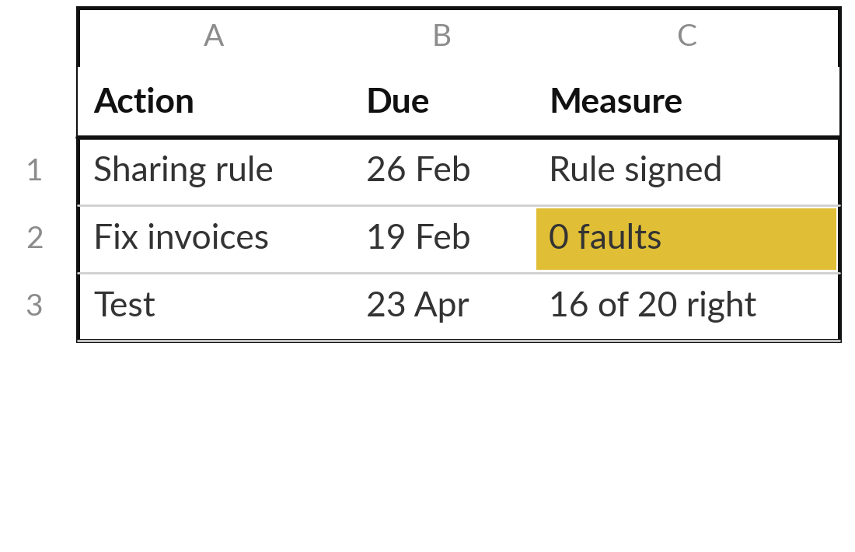
Turn your gaps and your
portfolio into a 90-day roadmap
20 minutes
Hands-on: your plan
Fill the Roadmap sheet of the 90-Day Roadmap.
Write your plan start date; the check-in dates follow.
One line per gap and per start-now use: action, owner, start, due, hours.
Fill Waits for, so rights and cleaning come before any test.
Write each success measure as a number someone else can check.
You keep: A roadmap of at least six actions with owners, dates, hours and measures.
Notes:
Your gaps and your start-now entry are the raw material, and each now becomes a line. You have twenty minutes, and I walk round. Open the 90-Day Roadmap, sheet Roadmap. Write your plan start date first; the check-in dates follow from it. Then one line for each of your top gaps and one for testing your start-now use.
Each line needs an action a person can finish, one owner, a start, a due date and the hours. Fill Waits for, so that rights and cleaning come before any test. Then rewrite every success measure as a number someone else can check. Aim for six actions. If you get stuck, ask yourself which fix, if skipped, would make everything else unsafe. That is action one.

Slide 29
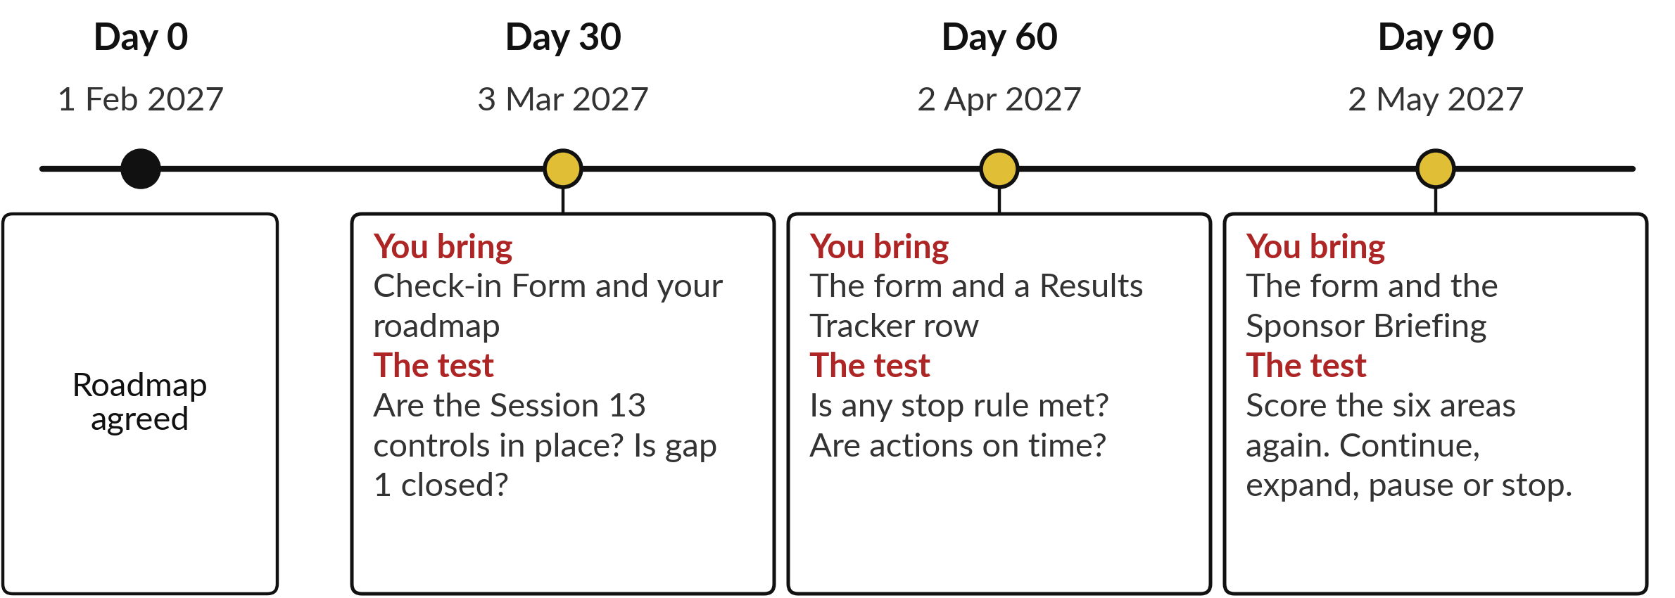
Three check-ins keep the plan
alive: day 30, day 60 and day 90
Dates for the fictional plan. Your own follow from your start date.
Notes:
A roadmap nobody reviews drifts, so the plan has three check-ins, like school reports at set points in a term. Your lecturer messages you before each one. At day thirty you bring the Check-in Form and your roadmap; the test is whether your Session 13 controls are in place and your first gap is closed.
At day sixty you add a row from the Results Tracker; the test is whether any stop rule from Session 11 is met and whether actions are on time. At day ninety you bring the Sponsor Briefing and score the six areas again. For Nile Valley Foods the target is nine of twelve, up from six, and invoice faults from eight to none. Then you decide: continue, expand, pause or stop.

Slide 30
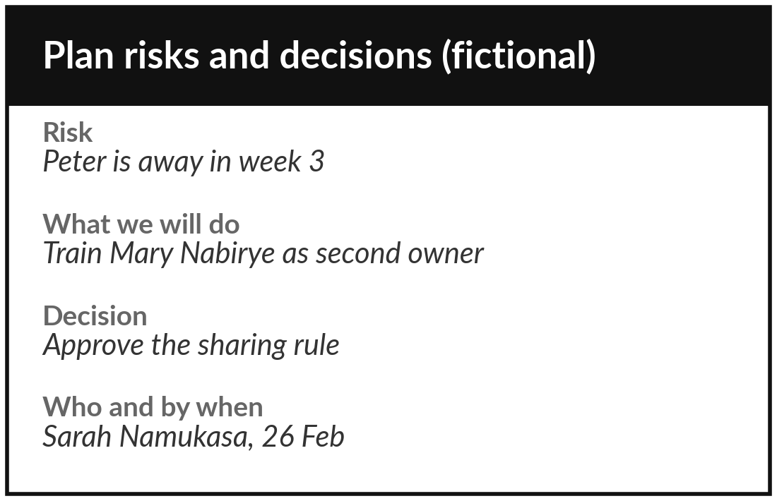
Set your check-ins, the risks to
your plan and the decisions it needs
10 minutes
Hands-on: your plan
Fill the Check-ins, Risks and Decisions sheets.
Check-ins: put your day 30, 60 and 90 dates in your diary now.
Risks: three risks to the plan, one about an owner being away.
Decisions: each decision needed, who decides, and by when.
Write your day 90 target: your score, and one count.
You keep: Three dated check-ins, three plan risks, a decisions list and a day 90 target.
Notes:
A plan also needs its dates, its risks and its decisions. Ten minutes for this last block, and I walk round. On the Check-ins sheet, read the three dates that follow from your start date and put them in your diary now, before you leave the room. On Risks, list three risks to the plan itself, with at least one about people, such as the owner of a key action being away.
Write what you will do about each. On Decisions, write each decision your organisation must make in the ninety days, who decides and by when. Finally write your day ninety target: the score you expect on the scorecard, and one count, such as invoice faults down to none.

Slide 31
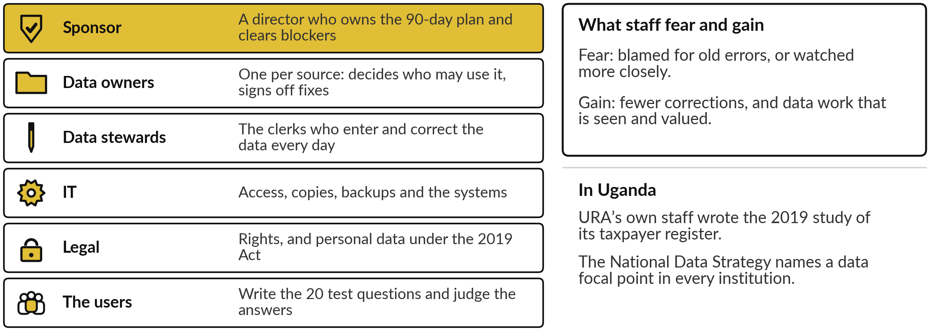
Data needs a sponsor, an owner for every
source, and the staff who keep it clean
Data readiness is a leadership job. IT builds the systems; owners decide who may use the data.
Notes:
Your plan is full of names, and each belongs to a person with a job to do. The sponsor is one director who owns the ninety-day plan and clears blockers. Each source has a data owner, who decides who may use it and signs off its fixes. The clerks who enter and correct data every day are the data stewards; their work becomes more visible and more valued.
IT runs access, copies and the systems, and your lawyer or data protection officer settles rights. The users write the twenty test questions. Staff fear being blamed for old errors or watched more closely; say plainly that the aim is clean data and that nobody is blamed for the past.
URA’s own staff studied its register, and the national strategy names a data focal point in every institution.

Slide 32
Before AI touches your data, ask who
owns each source and who may see it
Ask | Why it matters
Which sources will it use, and who owns each one? | With no owner, nobody fixes the faults
Who may see this data, and is any of it personal? | Rights is the Red that stops the work
How many faults did you count, and in which columns? | A count beats an opinion
Where will the data be stored and processed? | Location and the law, as in Sessions 6 and 13
Which 20 questions will we test it on, and what score is good enough? | Write the line for success first
Who keeps the data clean after the pilot? | Data slips back without an owner
Notes:
Everything today comes down to six questions you can put to your team or a vendor next week. Ask which sources it will use and who owns each one, because with no owner nobody fixes the faults. Ask who may see the data and whether any of it is personal, because rights is the Red that stops the work.
Ask how many faults were counted, and in which columns, because a count beats an opinion. Ask where the data will be stored and processed, as you learned in Sessions 6 and 13. Ask which twenty questions the test will use and what score is good enough, and write that line before the test.
And ask who keeps the data clean after the pilot, because without an owner it slips back. One decision remains.

Slide 33




One use finished usually beats three gaps started
How much will your plan deliver by day 90?
One use, finished
Three gaps, started
Test one folder now
Data first, no use yet
Fix its data and test it. A real result at day 90. Recommended.
More to show, less certainty at day 90.
Only if rights is not Red. Learn fast, then fix.
When most areas are Red. Cleaning is a result too.
Say your choice aloud, and write it at the top of your roadmap with your day 90 target.
Notes:
With your people named, one decision. How much will you take on in the next ninety days?
One use, finished: fix its data and test it fully, so you have a real, measured result at day ninety. That is what I recommend for most. Three gaps, started: more to show, less certainty. Test one folder now: only if rights is not Red, because testing data you may not use is the wrong order.
Or data first, with no AI use yet, when most of your areas are Red; ninety days of cleaning is a result too, as Vodacom and our own government show. Say your choice aloud, write it at the top of your roadmap, and name one action you will take in the next twenty-four hours.

Slide 34
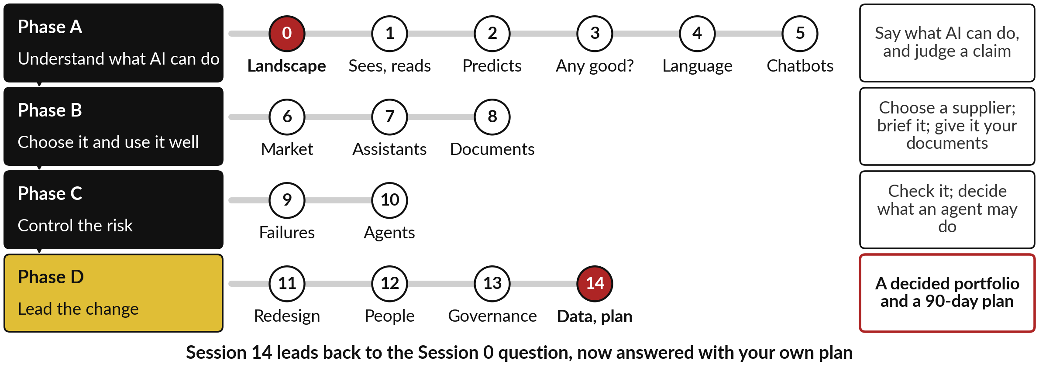
Fifteen sessions in one picture: four
phases, from the map to your plan
Each session built on the one before. Your portfolio grew in every one.
Notes:
With your decision written, step back and see the whole course on one page. Phase A, Sessions 0 to 5, was understanding what AI can do: the map, seeing and reading, predicting, judging a claim, language, and how chatbots write. Phase B, Sessions 6 to 8, was choosing it and using it well: the market, getting good work from assistants, and AI on your own documents.
Phase C, Sessions 9 and 10, was controlling the risk: failures and agents. Phase D, Sessions 11 to 14, was leading the change: redesigning work, leading people, governance and buying, and today’s data and plan. The last arrow runs back to Session 0: what is AI, and where is it at work in my industry? Answer it now, in two sentences.

Slide 35
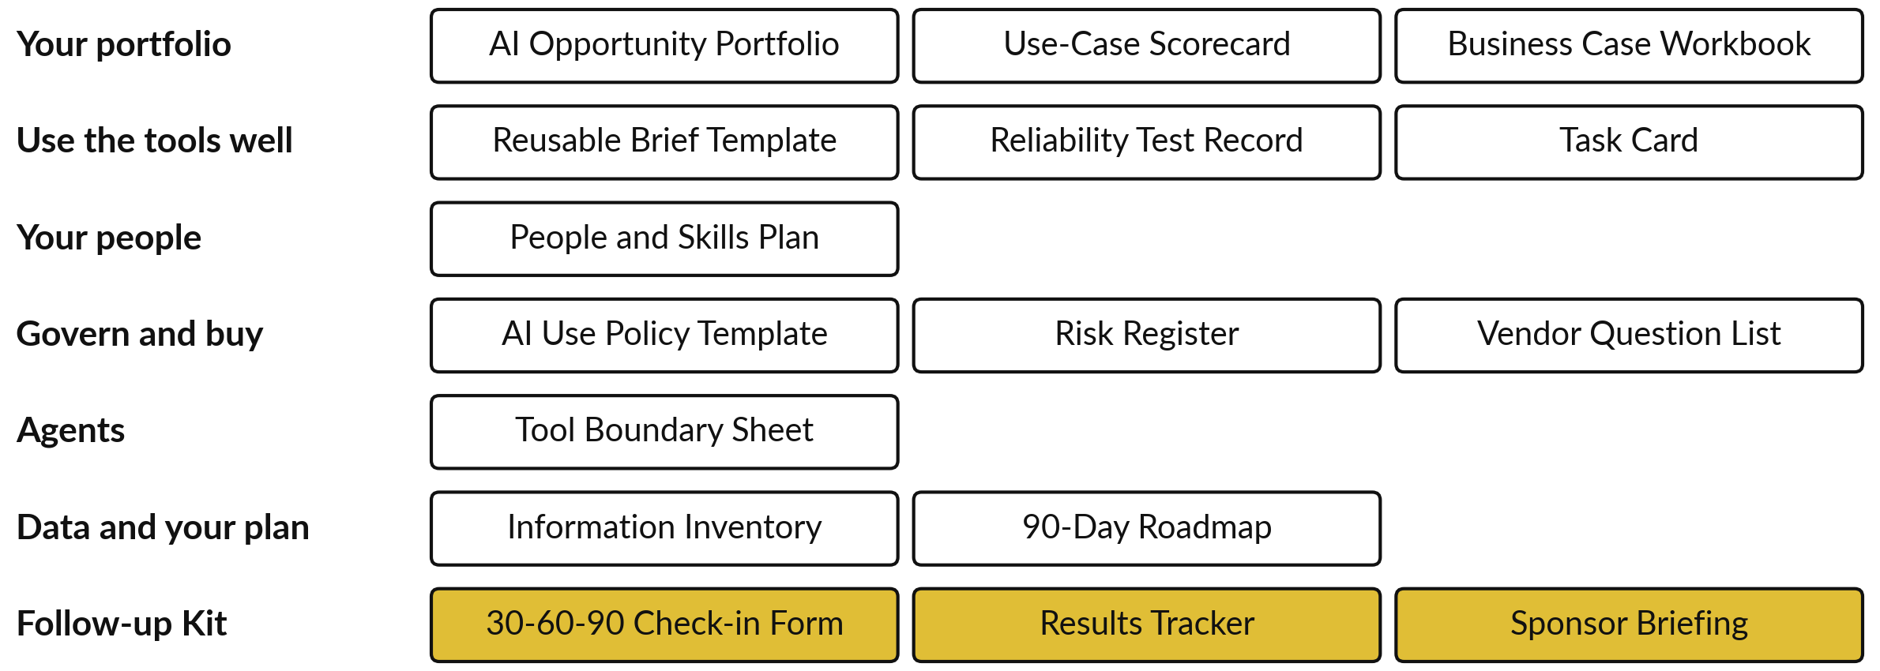
What you now hold: your working
papers and the Follow-up Kit
Notes:
That picture is the thinking; these are the papers you carry out of the room. Your portfolio, with the scorecard and the business case behind it. The brief template and the test record for using the tools well. Your People and Skills Plan. The policy, the risk register and the vendor questions.
The tool boundary sheet for agents. Your inventory and your roadmap. And in gold, the Follow-up Kit: the Check-in Form, the Results Tracker and the Sponsor Briefing. Papers do nothing alone. The plan moves when each action has a named owner and each date is in a diary.
So in the next twenty-four hours, book the three dates and tell each owner their action.

Slide 36
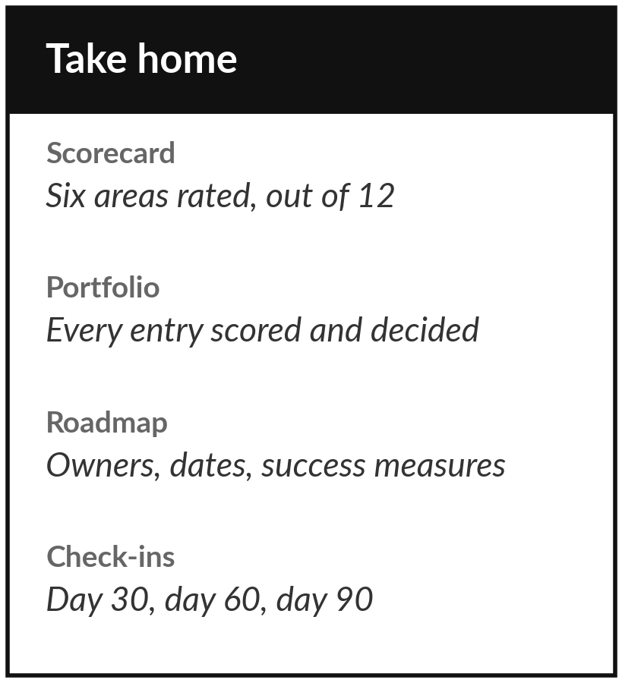
You leave with a decided portfolio,
a plan with owners, and three dates
What you keep from today
Your inventory and scorecard, your final AI Opportunity Portfolio, your 90-day roadmap with owners and check-ins, and the Follow-up Kit.
Our question today
Is our data ready, and what do we do in the next 90 days?
After the course
Check-ins at day 30, 60 and 90 from your start date. Your lecturer messages you before each; bring the form and your roadmap.
Notes:
Take everything home: your inventory and scorecard, your final portfolio, your roadmap and the Follow-up Kit. Within twenty-four hours, put the three check-in dates in your diary and tell each owner their action. Your lecturer messages you before each check-in. At day thirty bring the Check-in Form and the roadmap; at day sixty a row from the Results Tracker; at day ninety the Sponsor Briefing and a fresh score of the six areas.
Thank you for fifteen sessions. You began with a map of AI and a question about your industry. You leave with your own answer, written as a plan.
We began with this question: Is our data ready, and what do we do in the next 90 days? Before you go, say in one sentence what you can now say about it.

